Slide 1
Guidance of Reproducing the paper: Generating Semantic Annotations for Frequent Patterns with Context Analysis
CS 410 Course Project
Ye Xu, Weidi Ouyang, Raj Datta

Slide 2
Overview of the paper

Slide 3
Focus of the paper
Not about Frequent Pattern Discovery, but about “Interpreting the frequent pattern with semantic annotations by
Constructing the context model of the frequent pattern
Selecting context indicators
Extracting representative transactions and semantically similar patterns
Input: Frequent Pattern
Output: Semantic Annotation of that pattern

Slide 4
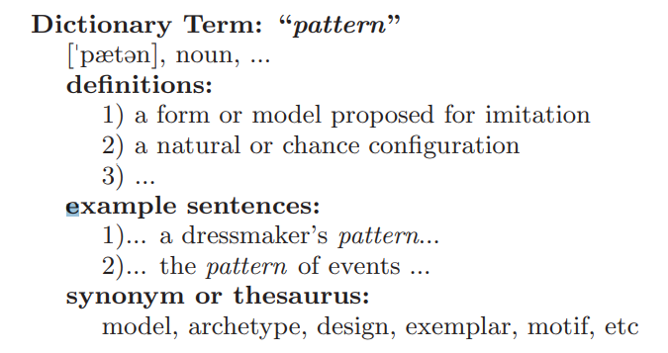
What is the semantic annotation of the frequent pattern
1. Semantic definition of the pattern can be inferred by its context and words sharing the similar context : Context indicator.
2. Extract the data transactions that best represent the meanings of the pattern.
3. Extract semantically similar patterns (SSPs) of the given pattern, i.e., patterns with similar contexts as the original pattern.

Slide 5
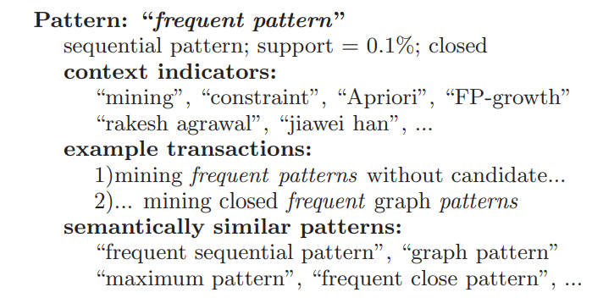
What is the semantic annotation of the frequent pattern
Definition
Example sentences
Synonyms or Thesaurus

Slide 6
Definitions and Problems
The Problem formulation section

Slide 7
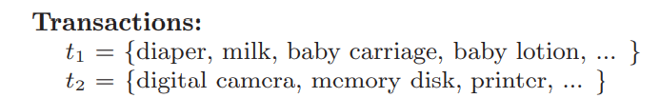
Some concept
Transaction: A collection of itemsets, sequences, graphs…
A pattern: A item, a subsequence, a subgraph…
Support:
Absolute number of transactions that contain the pattern
The proportion of transactions containing the pattern in the entire transaction dataset
Patterns: diaper, baby lotion, disk…
Support of “diaper”: 1 or 1/2

Slide 8
Some Concepts
Frequent Pattern: A pattern with support equal or larger than the specified threshold
Context Unit: An object from the transaction set that carries semantic information and co-occurs with at least one pattern in the pattern set and in at least one transaction of the transaction set.
Patterns: diaper, baby lotion, disk…
Support of “diaper”: 1 or 1/2
If the threshold = 1 or 0.5, “diaper” is the Frequent Pattern

Slide 9
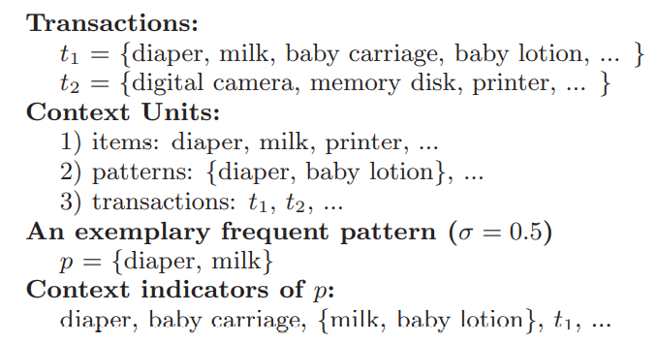
Some Concepts
Context indicator: A select Context Unit of a Frequent Pattern. Each of such units co-occur with the Frequent pattern and associate with a weight to measure its strength of semantic indication of the pattern

Slide 10
Major Task
Define context units to form the context vector space;
Design a strength weight for each unit to model the contexts of frequent patterns in order to extract the most significant context indicators as the “definition” for the given pattern unit.
Design similarity measures between a transaction and a pattern context and between the contexts of two patterns in order to extract representative transactions and semantically similar patterns to finalize the structured annotation of a given frequent pattern.

Slide 11
Context Modeling

Slide 12
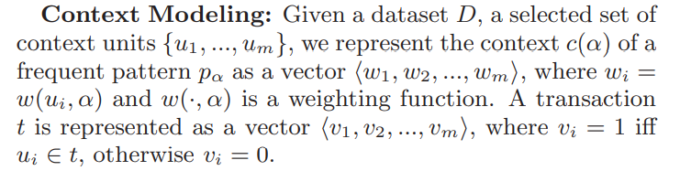
Vector Space Model for Context modeling
A transaction and the context of a frequent pattern both are represented as vectors of context units.

Slide 13
Context unit selection
Very flexible: Any object in the database that carries semantic information or serves to discriminate patterns semantically can be a context unit.
single items,
transactions,
Patterns
any group of items/patterns
In the paper, Context unit = Pattern
Redundancy Reduction → Context unit == Closed Frequent Pattern
Closed Frequent Pattern: A frequent pattern is closed if there exists no super-pattern that has the same support count as this original pattern.
How to Find Closed and Maximal Frequent Itemsets from FP-Growth | by Andrewngai | Towards Data Science
Further Redundancy removal by micro-clustering (Both are agglomerative clustering with complete link)
Hierarchical clustering
One pass clustering

Slide 14
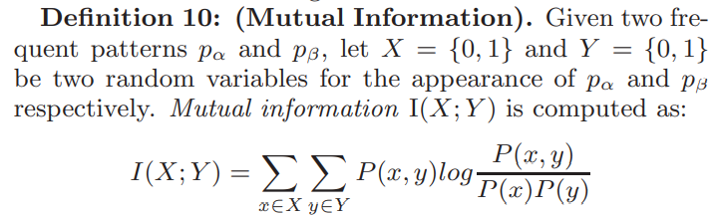
Strength Weighting for Context Unit
Intuitively, the strongest context indicators for a pattern should be those units that frequently co-occur with this pattern but infrequently co-occur with others.

Slide 15
Extract Strongest Context Indicator As the Definition
With the weighting function for each context unit (u_{i}) of a pattern, compute w_{i} = w(u_{i}, p_{α}), rank u_{i} ∈ U with w_{i} in descending order and select the top k units.

Slide 16
Semantic Analysis and Pattern Annotation

Slide 17
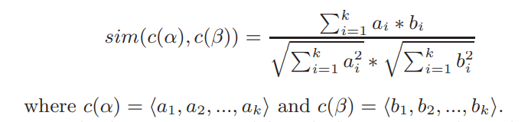
Semantic Similarity
For Pattern p_{α}, its context vector is a vector of unit weighting functions c(α) = [w(u₁, p_{α}), w(u₂, p_{α}), ..., w(u_{k}, p_{α})], where u_{i} is the select context unit (closed frequent pattern).
Cosine distance is used to compute the similarity between two context vectors.

Slide 18
Extracting Representative Transactions
Represent a transaction as a vector in the same vector space as the context model of the frequent pattern p_{α}, i.e., c(t) = w₁, w₂, ..., w_{k.}
Compute Cosine Similarity between the transaction and the pattern: s(c(t), c(p_{α} )).
Rank the similarity in descending order and select top k transactions.

Slide 19
Extracting Semantically Similar Patterns
let Pc = {c(p₁), ..., c(p_{c})} be the context vectors for {p₁, ..., p_{c}} which are believed to be good candidates for annotating the semantics of p_{α}.
Compute sim(c(p_{i}), c(p_{α})) for each p_{i} ∈ Pc, rank them in descending order, and select the top k p_{i}’s.
Pc can be very flexible (e.g. the whole frequent pattern set).

Slide 20
Workflow of the DBLP dataset

Slide 21
Parsing Raw Data
Find closed FPs of Authors as Context Units
Find closed Sequential FPs of Titles as Context Units
Preprocessing titles
FP mining
Processing title FPs
Combine FPs of Authors and Titles to form Context Units Space
Weight Matrix of Context Units
Annotation of Given Pattern by Context Units with Top Weights
Find representative titles of given pattern
Find synonyms of given pattern

